Slide 1
Mail My Voice
A Postcard Activism Platform

Slide 2
An Enterprise Architecture Demonstration
Enterprise level architecture bridges business strategy and market opportunity to a technology strategy that guides the entire development organization.

Slide 3
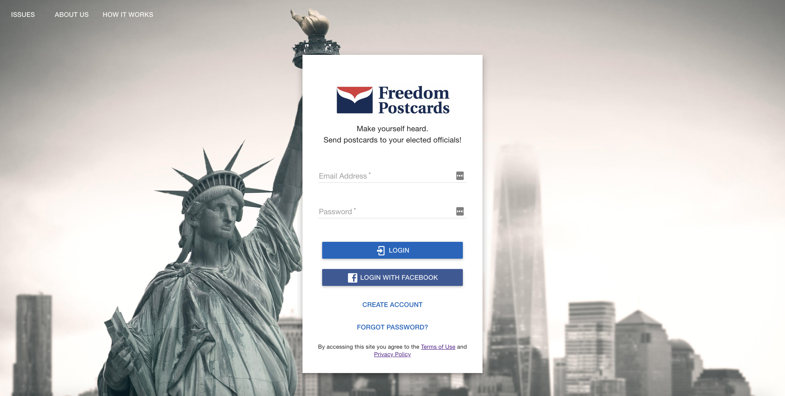
Background Freedom Postcard

Slide 4

The Opportunity
Broaden the appeal to a larger demographic
Increase overall revenue through an increase in sales volume
Decrease overall operating costs
Add analytics functionality that maps issues to regions, demographics, elected officials and other factors
Streamline the efficiency of the overall technical architecture

Slide 5
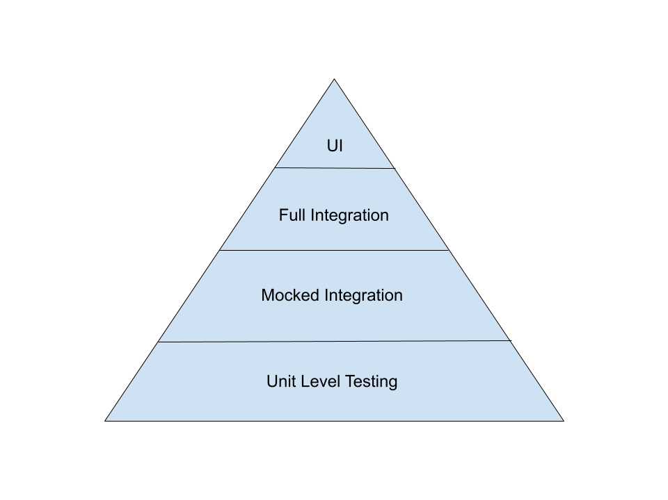
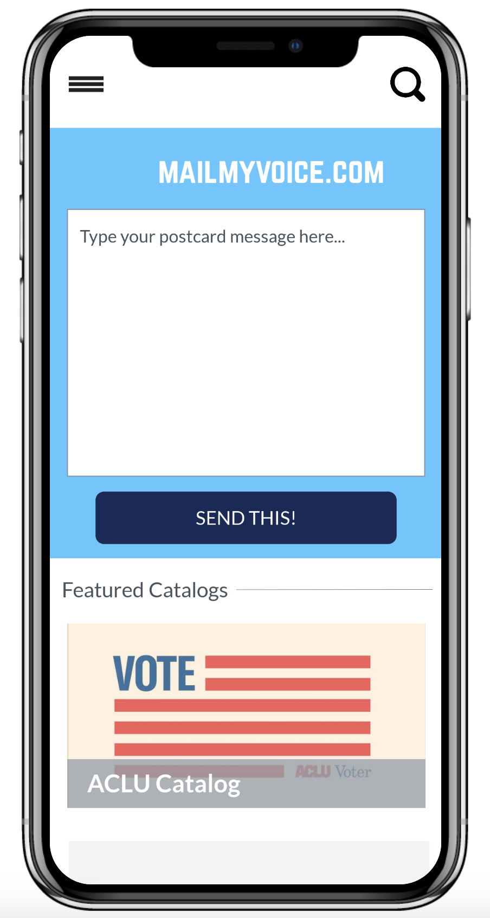
Quality Considerations
Acceptance Criteria
Testing, Performance & Security Strategy

Slide 6
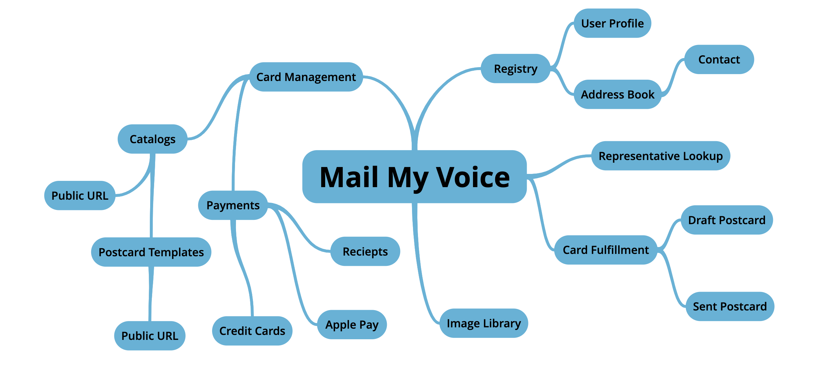
Domain Ontology

Slide 7
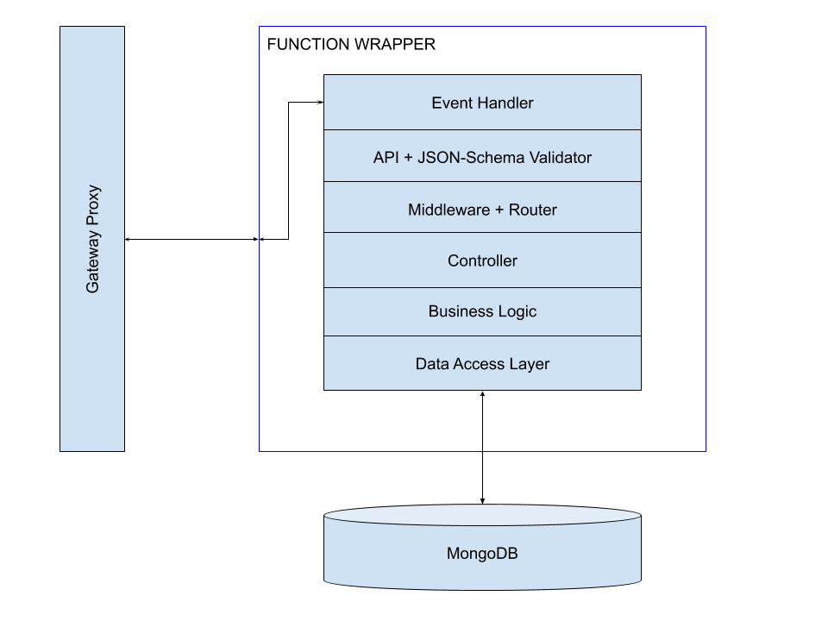
From Docker to Lambda
Reduces costs dramatically
Ensure we account for the event triggered function architecture as apposed to traditional ”always on” server
Utilize schema validation
Benefits of middleware in a lambda function
Serverless.com

Slide 8
Domain and Data Modeling
Use the ontology to draw boundaries
Understand relational data limitations
Model the domain as one or multiple related models
Use a schema language to further refine these entities as canonical (JSON-schema)
Model data in a way consistent to the domain needs (SQL, document, graph…)
Don’t overdo it with the internal data models, the implementing team will have the final say

Slide 9
Everything up till now constitutes V1 MVP
The live demo scheduled for the end of this presentation is specific to V1.
Any questions up to this point?

Slide 10
Data Analytics: Data Transport
I should have the option to publish with or without an acknowledgement
I should be able to create a connection for both publishing and consuming - requires that the technology have supported libraries
I should be able to monitor traffic, volume, and overall load
I should be able to inspect data if required
I should be able to moderate/manage topics/streams
It should guarantee at least once delivery
It should be end-to-end secure

Slide 11
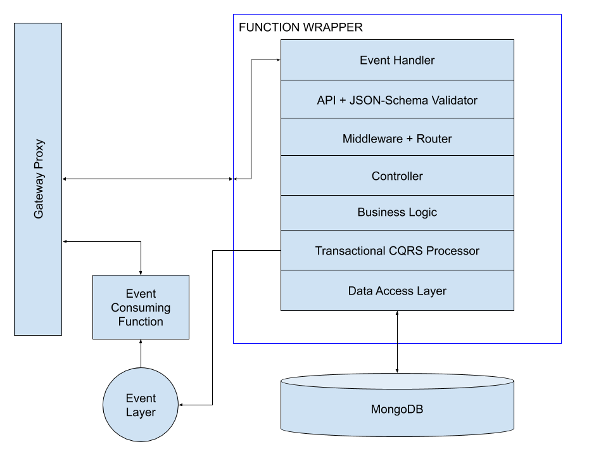
Data Analytics: The Functions
Modify the functions to publish to the event layer
Use a CQRS Strategy to ensure data is published and to deal with eventual consistency problems
Notes:
Command Query Responsibility Segregation

Slide 12
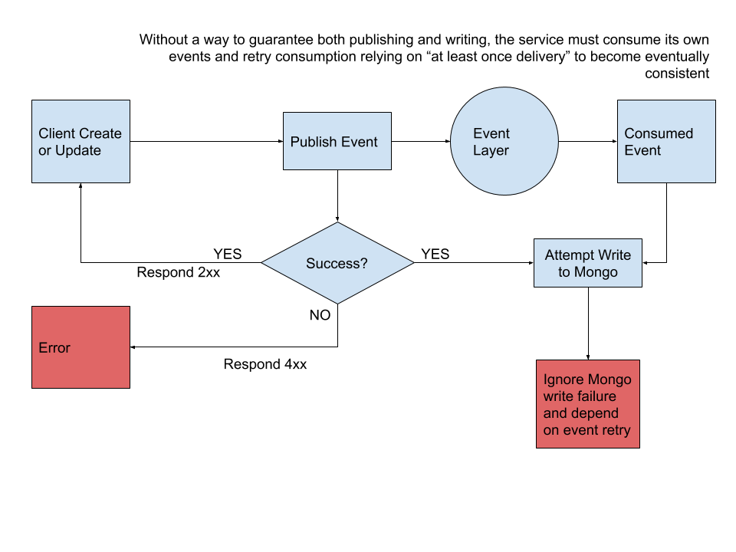
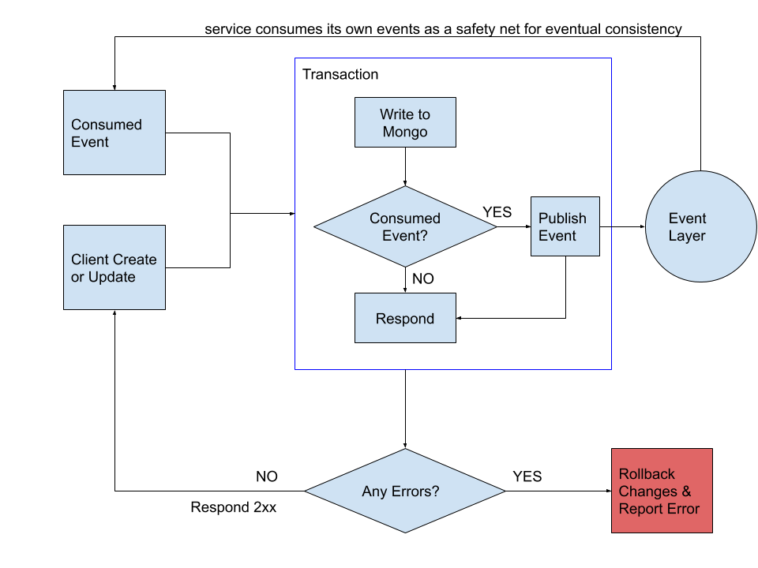
CQRS Approaches
Non-transactional
Transactional

Slide 13
Example Questions we Hoped to Answer
How many people purchase any given saved postcard?
How many of a single postcard are sent from each US region?
Which representatives receive the most postcards in total?
Which representatives received a given postcard and how many of that card did they get?

Slide 14

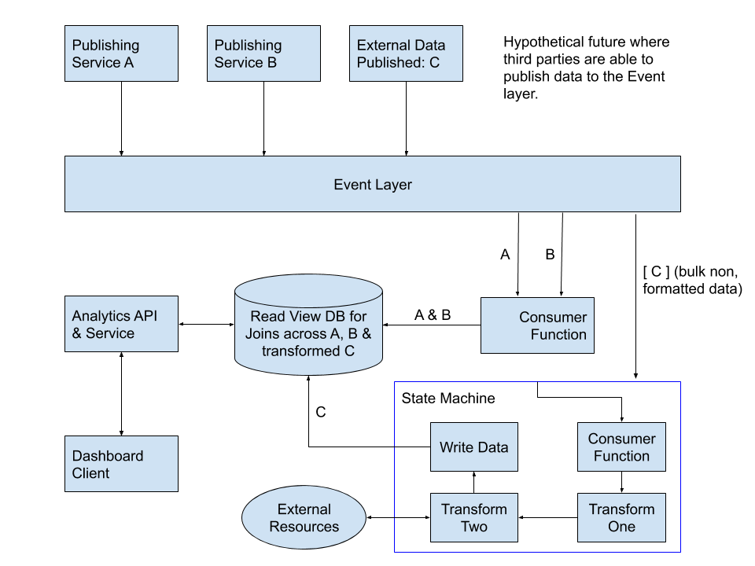
Data Analytics: Eventual Architecture

Slide 15
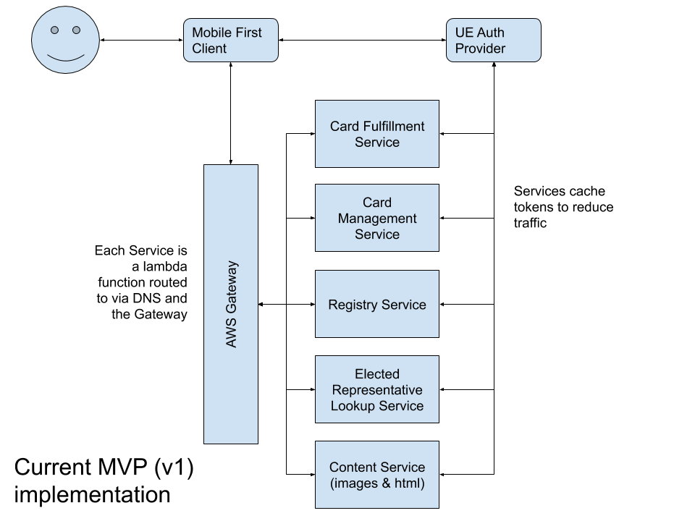
Mail My Voice: MVP
Estimated Effort:
16 weeks in person hours

Slide 16
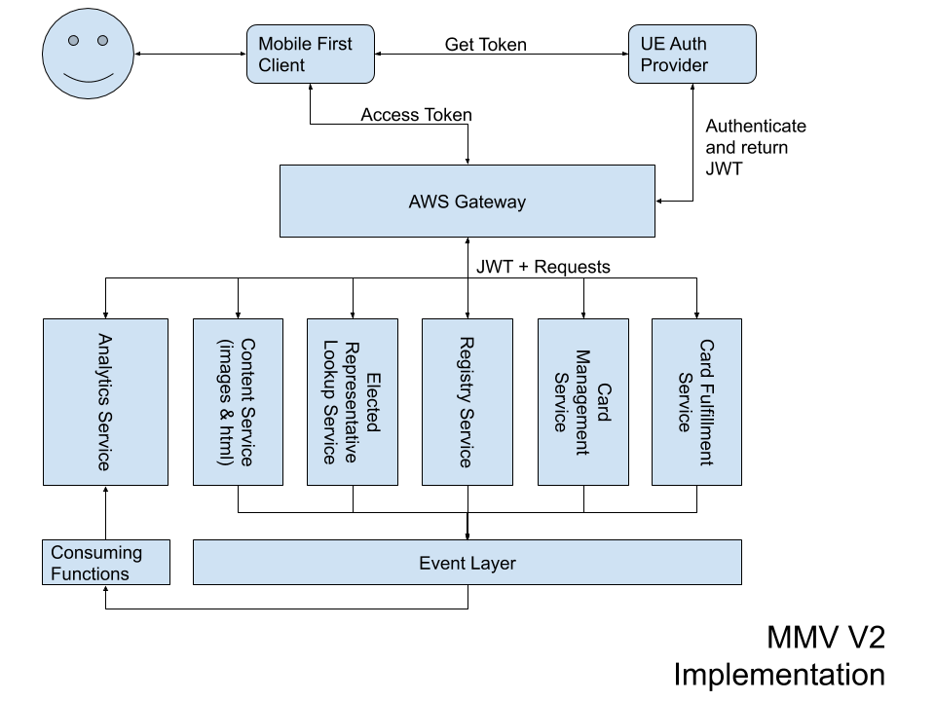
Mail My Voice: V2
Estimated Effort:
16 weeks in person hours

Slide 17
Business Value: Should this be Built
To answer that you have to define value – something we simply assumed had been done for this demonstration; however, you would follow the below approach
Business Value, otherwise known as Cost of Delay, can be defined at an initiative level
Impact to Business Growth
Impact to Business Scope (customers)
Impact to Profitability
Market Differentiation Impact
Opportunity to Learn
These can be quantified as relative scores and compared to a cost

Slide 18
Defining Cost
There are hard costs that are obvious such as resourcing, which is why defining effort is useful, but other factors have to be considered:
Implementation Readiness – are there resources available?
Calendar Time to Implement – see effort and resourcing
Business Process Complexity – how new is this?
Cost of Ownership – are we taking a shortcut or other strategies that will cost us over time?
Implementation Leadership – Are we inventing this ourselves or is their leadership?
These can also be quantified as relative scores, though we can define a resource cost more accurately:
Assuming loaded FTE of $150p/h, MVP and V2 are both priced at $96,000
Ultimately, you want to prioritize the highest value for the least cost that best positions the company while taking on the least risk

Slide 19
THANK YOU Questions?
You can view the detailed Design Sketch for this architecture here:
https://github.com/theBoEffect/mmv-architecture-demo

